Slide 1
Checkmate
Final Presentation
Presented by Esai Jimenez, Autumn Hale, & Trentin Barnhart

Slide 2
Introduction
Checkmate is a website that provides users with a platform to attempt various chess puzzles in a digestible and interactive way
User given a standard 2D 8x8 chessboard with a chess puzzle position set up
Difficulty increases as each puzzle is solved
Competitive edge because there is a limited number of lives and amount of time
Leaderboard for high scoring players

Slide 3
Introduction (cont.)
Tutorial page to reference for piece movement and special rules
Create custom puzzles or play other user-created puzzles, a unique feature of Checkmate
Legal move indicator dot option for in-game guidance
Checkmate provides a fun and interactive way for users to improve their chess skills
An ideal tool for chess enthusiasts of all skill levels

Slide 4
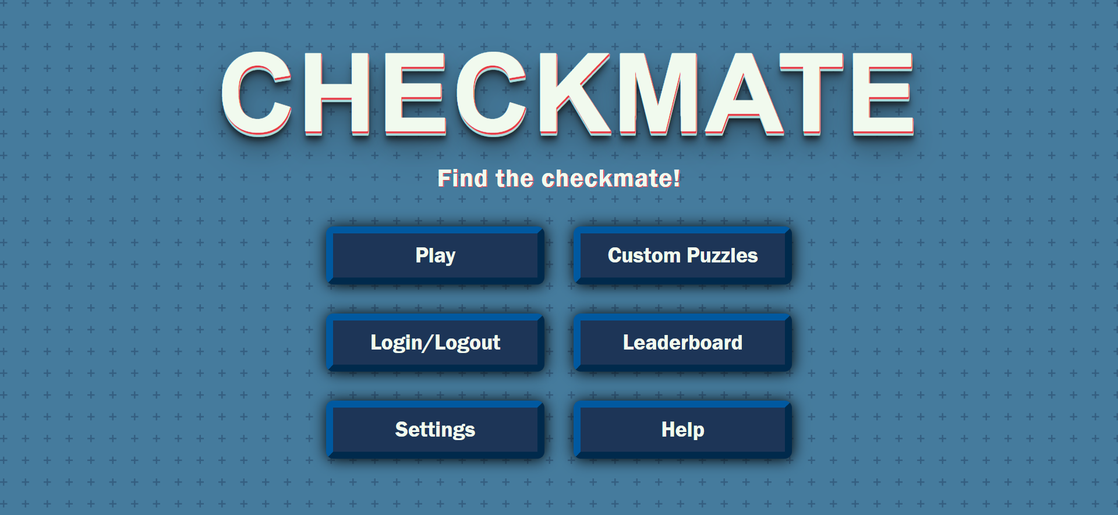

Slide 5
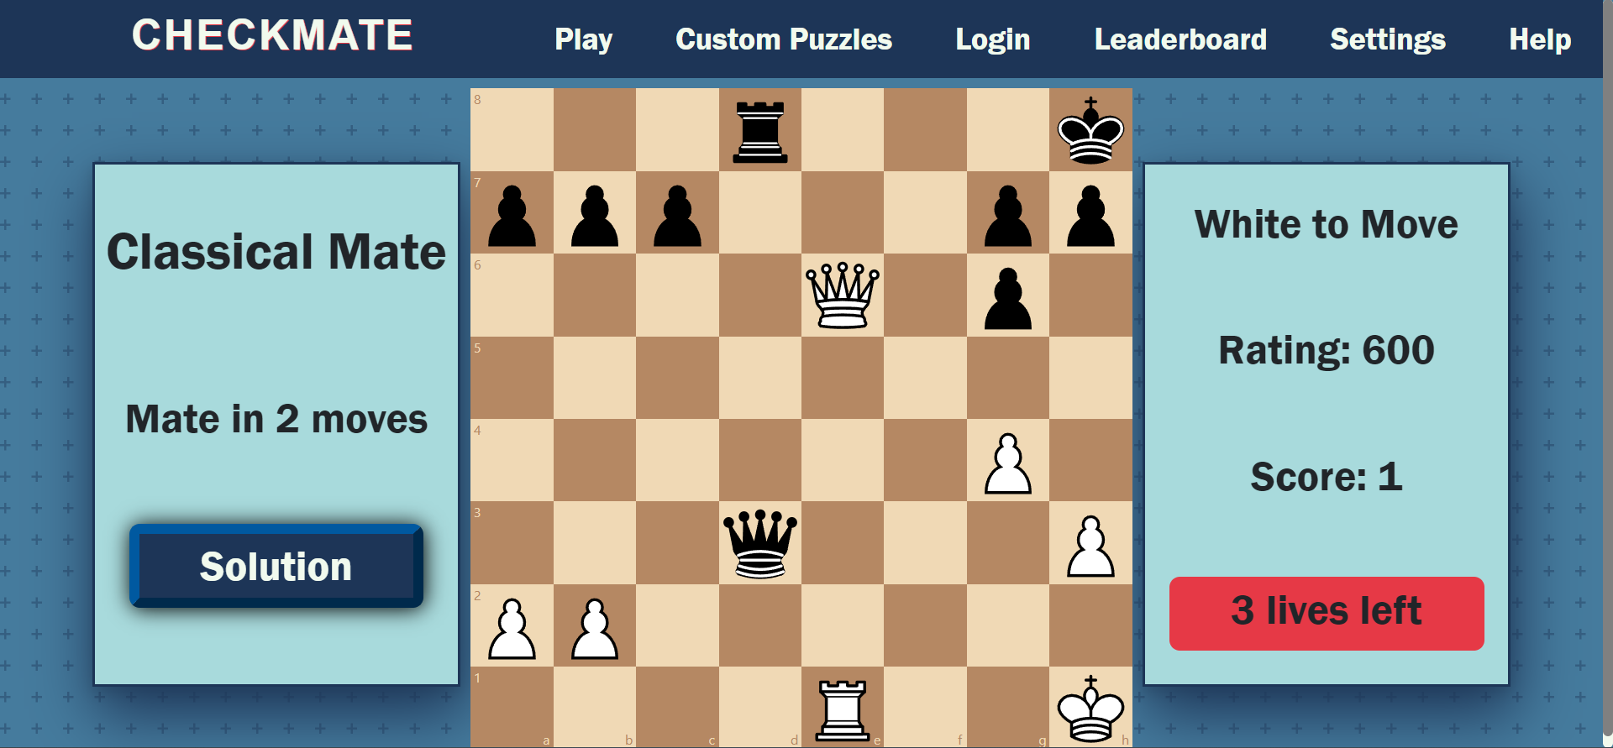

Slide 6
Technology
All technology used:
React.js (used for over 70% of project, all logic)
HTML & CSS (core web development languages)
Python’s Pandas library (filtering Lichess puzzle database)
JavaScript’s Chess.js library (chess logic)
Lichess puzzle database (database of over 3m puzzles, contains metadata)
Chessboard.jsx (spare pieces for custom puzzles)
React’s react-chessboard library (visual elements)
Google Firebase (Hosting, Storage, Authentication, Realtime Database)
Checkmate was developed using Visual Studio Code and is housed on Github using Git as its version control software

Slide 7
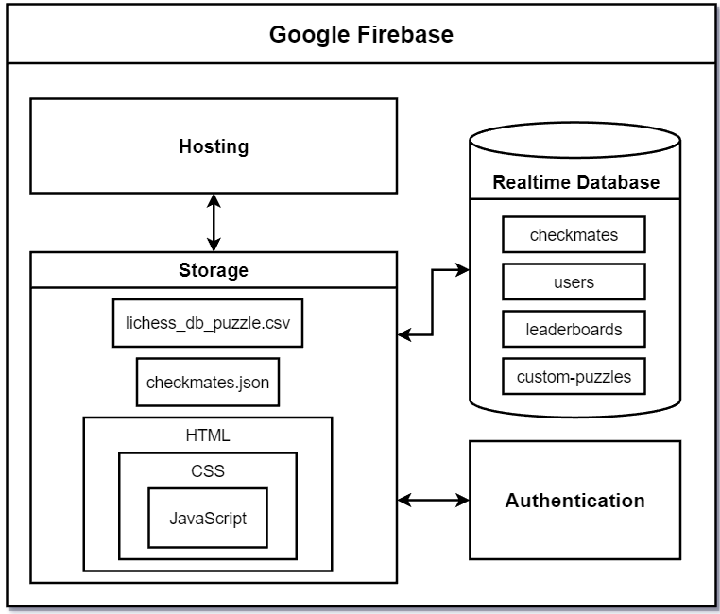
Block Diagram

Slide 8
Design: Database
checkmates: These are the puzzles pulled from the Lichess open source database. Includes the information required to display and solve all of the chess puzzles; the largest scale of storage in the project.
custom puzzles: Data on custom puzzles provided by users.
leaderboards: The high scores for each mode; Classical and Bullet Mate leaderboard data.
users: Data on all users who sign up on Checkmate.

Slide 9
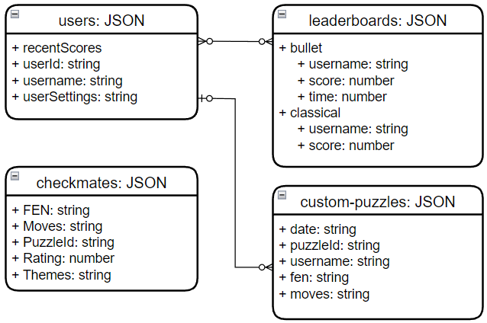
ER Diagram

Slide 10
Design: Components
Checkmate.js, firebase.js, and index.js hold configuration data
Every page has a UI js file and an associated css styling file
Additional functional classes include
FailedPlayPuzzle.js: failing a custom puzzle (Popop)
GameOver.js: losing all lives on a standard gamemode (Popop)
GameOverLeaderboard.js: losing all lives BUT achieving a high score (Popop)
Navbar.js: used for creating the navigation bar
PuzzleSubmission.js: submitting a custom puzzle (Popop)
SuccessPlayPuzzle.js: succeeding on a custom puzzle (Popop)

Slide 11
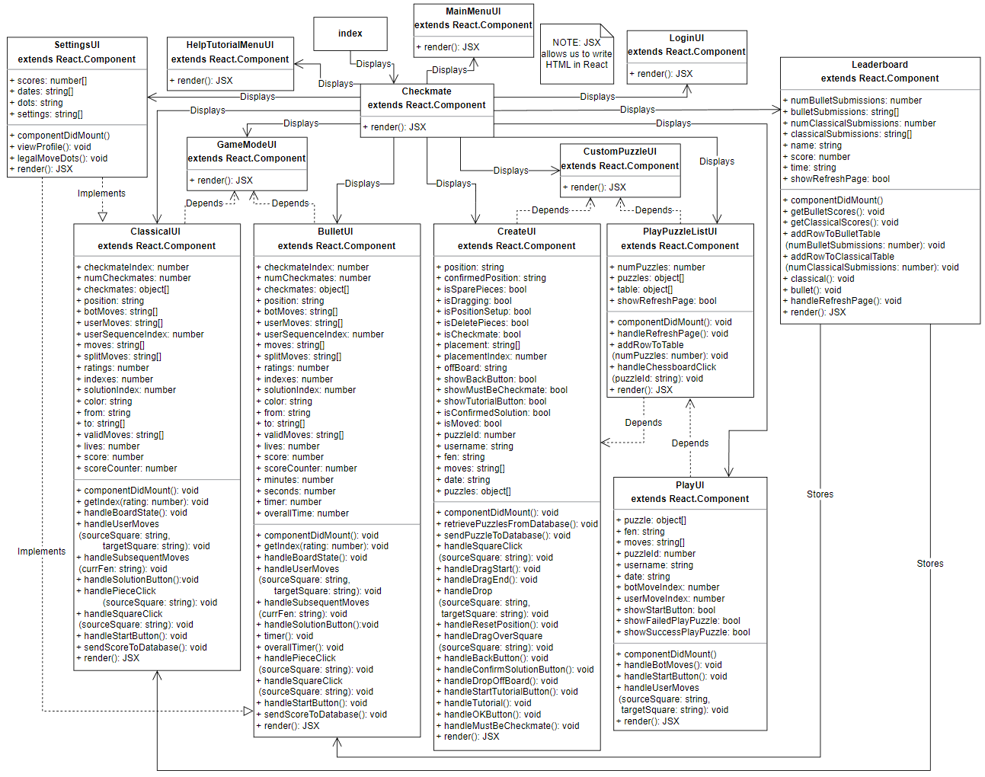
Component Diagram

Slide 12
Deployment Instructions (simplified)
Install Node.js, Visual Studio Code, create Firebase account
Navigate to https://github.com/esaijimenez/Checkmate and clone the repo
Run “npm install”, “npm install firebase”, and lastly “npm install -g firebase-tools”
Create a firebase.js file, this will include all the configurations provided by Firebase
Run “npm run build”, “firebase login”, “firebase init”, then “firebase deploy”.
Quick startup:
Clone repo
Run “npm install”
Run “npm start”

Slide 13
Known Bugs
Visual Glitch: Pop In
Apparent in both modes. Board repeatedly pops in and out during initial load. Occurrence has reduced significantly during the development process.
May be fixed by styling and rendering the board according to the user’s screen size.
Visual Glitch: Flying Pieces
Apparent in both modes during gameplay. When a puzzle is complete, game pieces “fly” off of the board.
May be fixed by a deep dive on the source code, react-chessboard documentation, and styling according to user’s screen size.

Slide 14
Known Bugs (cont.)
Gameplay: Specific Puzzle
On puzzles where the queen is supposed to deliver a checkmate but another piece checks the king on the exact same square that the queen was supposed to move to, the game essentially stops working and does not know what to do about this position.
Only observed once, and we are uncertain how to replicate it.
If this issue becomes more apparent it will be looked into further.

Slide 15
Future Work
Practice mode: Lets a user set a specific starting elo for the puzzles they attempt, so that proficient players can jump to their level right away.
Dark/Light Mode, Themes, & Board Customization: Modern day quality of life feature on websites. Themes across the website would set Checkmate apart. Board customization would allow for piece and board style and color customizability.
Real-Time Racing: Players compete one-on-one against each other to complete puzzles.

Slide 16
Future Work (cont.)
Profile Page: Profile picture, graph of puzzle progress, associated information, achievements, etc.
Gameplay Improvements: Record of all moves made, additional modes, board flip option, and sound when pieces move.
Accessibility: Allow for more people to enjoy Checkmate by implementing features for those with specific needs.
Multi Browser Support: Ensure Checkmate is compatible with other modern browsers.

Slide 17
Questions?

Slide 18
Demo Time!

